Slide 1

Safe, Efficient & Effective
Inside Out Is Best!

Slide 2


Benefits from sealing air ducts
Enhanced Building Pressurization
Improved Indoor Air Quality
3. Lower Energy Costs
4. Meet Code Standards
Help with re-commissioning and retro-commissioning
Notes:
Why is the demand for Aeroseal duct sealing growing so fast – because it addresses three core issues – air quality, building pressurization and energy efficiency.
Last year at a presentation at the national meeting of test and balance engineers, we saw a 100% agreement that duct leakage is 1 of the top 2 or 3 biggest issues that they face in system commissioning. Quick show of hands – have you had a project recently that had air balance issues? How did they deal with it?
We all know the problems our industry has seen with mold and illness caused by under performing HVAC systems. Let me give you 2 interest recent examples to make my point.

Slide 3



Air Ducts Leak
Light Commercial duct leakage is typically 30% or more⁽¹⁾
Leakage Classes >C_{l} = 200 are common⁽²⁾
On average, 10-20% of air provided by supply fans does not reach the occupied space⁽³⁾
Sources:
(1) Florida Solar Energy Center, California Energy Commission Studies
(2) Lawrence Berkeley Nat’l. Laboratory Studies
(3) Lawrence Berkeley Nat’l. Laboratory Studies
Notes:
Let me give you several data points on duct leakage 2 independent studies covering hundreds of buildings – One in California sponsored by one of the largest utilities – Pacific Gas and Electric and one in Florida conducted the FSEC both arrived at the same conclusion. Light commercial duct systems – those with a typical design pressure of <2 in WG were incredibly leaky. 30% of the air never made it inside the building. Think about that a 10 ton package unit where 3 tons of cooling are lost… its no wonder the system is running contently and never keeping up on design days.
No lets look at larger duct systems. There has been less research here but the results are pretty clear. Duct leakage is much higher than would be predicted with SMACNA guidelines. Remember SMACNA says that an unsealed duct should have a leakage class of around 48 – in this first study the authors found that high pressure ducts routinely had an equivalent class of 200 – no wonder buildings can be balanced, smell and have mold issues.
Another study concluded that 10-20% of the air didn’t get to the occupied space.
Wow – assuming those number are true – you would be correct to assume that there would be a big improvement in building performance if we were able to get the air to where it should be and it didn’t end up in a building cavity of worse – lost to the outside.
Now lets convert that gut feel to a number – what is the impact to the system efficiency if the ducts are as leaky as these results indicated…..

Slide 4
Cost of Leaking Ducts
+71%
+53%
Annual Fan Operating Cost
+41%
+17%
Duct Leakage Class
Notes:
Remember the ASHRAE statement that a 20% increase in exhaust fan leakage causes a 95% increase in fan power consumption….
This chart shows the increase in operating cost of the just the fan if the ducts are leaking more than a leakage class of 3 – a common leakage class for high pressure duct systems.
As you can the operating cost of fan would be 70% or more if the ducts were leaking to a class level of 48 or more. And remember – the previous slide – leakage levels as high as 200 are common. Think about the opportunity for improving building efficiency if we could just get the duct leakage down to the recommended level of 3…..
Assumptions:
Fan CFM = 40,000 cfm
Fan system efficiency* = 75%
Energy costs = $1 kWh
System effy is empirical measurement determined by the DOE at LBNL and is a composite of fan motor efficiency, drive efficiency, fan efficiency based on the typically static pressures seen by fans installed in HVAC systems.
Now let me give you some real world examples of the wins building owners have seen when they sealed their ducts

Slide 5
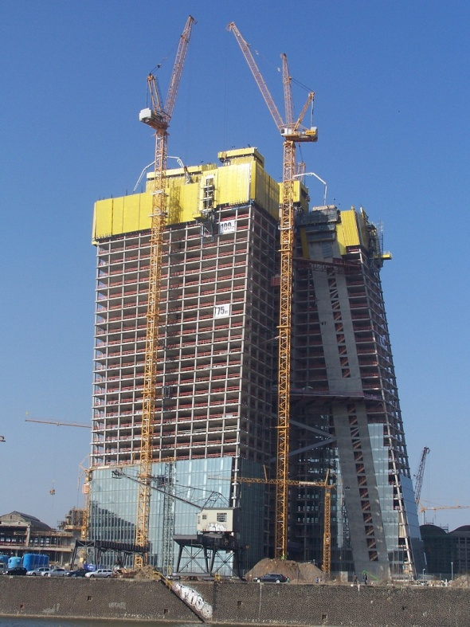
New Construction Benefits
Reduce Call Backs – Real time
verification of actual leakage
Increased success in passing duct
leakage test during commissioning
Ensures both new and existing duct
systems comply with engineers
specifications
Ensures both high-, medium- and
low-pressure ducts are efficient
Overcomes most installation issues
Three to five times faster than hand sealing
Exceeds the most demanding leakage limits

Slide 6
Constant Air Volume System Estimate of Fan & Cooling Plant
Annual Savings from Aeroseal
AHU SA Volume 140,000 total cfm
System Operation: 12hr per day/200 days yr.
EL Energy cost: $0.13/kWh
EL Demand cost: $8.00/kW
Outdoor air: 30%
Initial leakage: 20% of total fan flow
Reduction in Leakage: 96% of initial leakage
Location: Knoxville, TN
Indoor Cooling Set point: 72 deg. F
Indoor RH: 45%
Indoor Enthalpy: 25 Btu/lb
Fan speed: 100% constant
Cooling Plant Efficiency: 10 EER
Estimated Annual Savings
(using Aeroseal Savings Estimator spreadsheet v3)
Estimated Annual Cooling Plant EL Energy Savings from reduced Outside Air Load
Estimated Annual Cooling Plant EL Energy Savings from reduced
fan motor heat in airstream
Estimated Annual Supply Fan & Cooling Plant EL Demand Savings
Estimated Annual Cooling Plant EL Energy Savings from sealing

Slide 7
Variable Air Volume System* Estimate of Fan & Cooling Plant
Annual Savings from Aeroseal
AHU SA Volume 140,000 total cfm
System Operation: 12hr per day/200 days yr.
EL Energy cost: $0.13/kWh
EL Demand cost: $8.00/kW
Outdoor air: 30%
VFD Op Schedule: 20% hrs. @ 100% full speed
50% hrs. @ 75% full speed
30% hrs. @ 50% full speed
Initial leakage* 20% of total fan flow
Reduction in Leakage: 96% of initial leakage
Location: Philadelphia, PA
Indoor Cooling Set point: 72 deg. F
Indoor RH: 45%
Indoor Enthalpy: 25 Btu/lb
Cooling Plant Efficiency: 10 EER
*assumes all leakage is upstream of VAV boxes
Estimated Annual Savings
(using Aeroseal Savings Estimator spreadsheet v3)
Estimated Annual Cooling Plant EL Energy Savings from reduced Outside Air Load
Estimated Annual Cooling Plant EL Energy Savings from reduced
fan motor heat in airstream
Estimated Annual Supply Fan & Cooling Plant EL Demand Savings
Estimated Annual Cooling Plant EL Energy Savings from sealing
*Pressure Independent System

Slide 8
Central Exhaust System Estimate of Fan & Cooling Plant
Annual Savings from Aeroseal
AHU SA Volume 6,000 total cfm
System Operation: 12hr per day/200 days yr.
EL Energy cost: $0.13/kWh
EL Demand cost: $8.00/kW
% Replacement air: 100% (replacing all exhaust air)
Initial leakage: 20% of total fan flow
Reduction in Leakage: 96% of initial leakage
Location: Sacramento, CA
Indoor Cooling Set point: 72 deg. F
Indoor RH: 45%
Indoor Enthalpy: 25 Btu/lb
Fan speed: 100% constant
Cooling Plant Efficiency: 10 EER
Estimated Annual Savings
(using Aeroseal Savings Estimator spreadsheet v3)
Estimated Annual EL Energy Savings for Exhaust Fan
Estimated Annual Make-Up Air or Cooling Plant EL Energy
Savings from reduced fan motor heat
Estimated Annual Exhaust Fan & Make-Up Air or
Cooling Plant EL Demand Savings
Estimated Annual Make-Up or Cooling Plant
EL Energy Savings

Slide 9
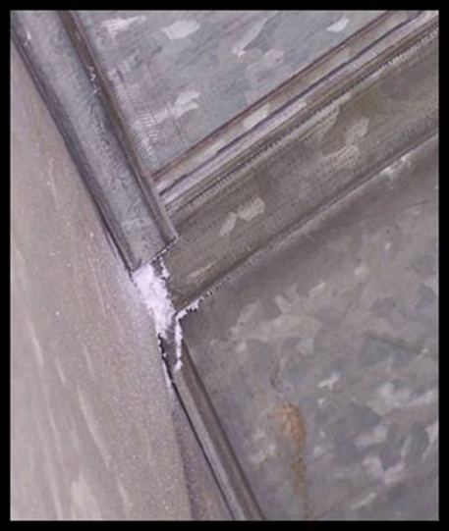
Aeroseal Overview
Proven, patented technology
Seals ducts from the inside out
  Reduces 90% of leakage
Overcomes human shortfalls
  Finds and seals all leaks
  No access limitations
  Duct wrap not removed
Verifiable & guaranteed

Slide 10








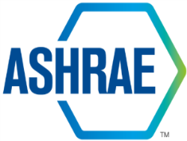


Timeline & Recognition
2011
2010
2007
2004
2001
1999
1997
1994
Over 3 Million ft² of Commercial Space Sealed
Certified
JMD Corp acquires Aeroseal from Carrier
2012
Task force approved measure
Patent issued for non-clogging nozzle
Approved energy savings
2011 EBie award
First commercial job
Carrier acquires Aeroseal
10,000 homes sealed
Certified
2011 best new home product award
First Aeroseal sealing process patent issued
Aeroseal founded
Recognized in 2005
2002 100 most beneficial technologies in 23 years
Patent awarded to Lawrence Berkeley National Laboratory
1996

Slide 11
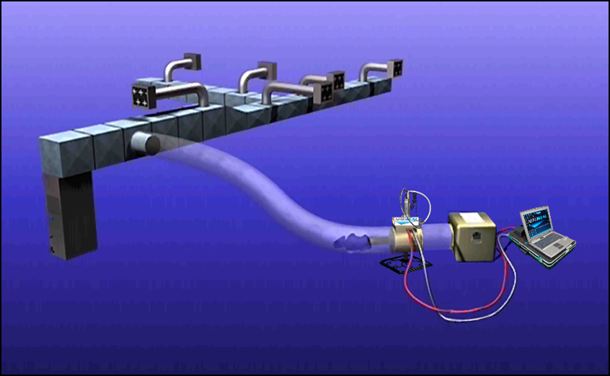
Overview of Application Steps
Connect equipment
Isolate Air Handlers
Block registers
Pre-Seal: Benchmark
Seal: Inject sealant
Post-Seal: Measure final leakage
Present certificate

Slide 12
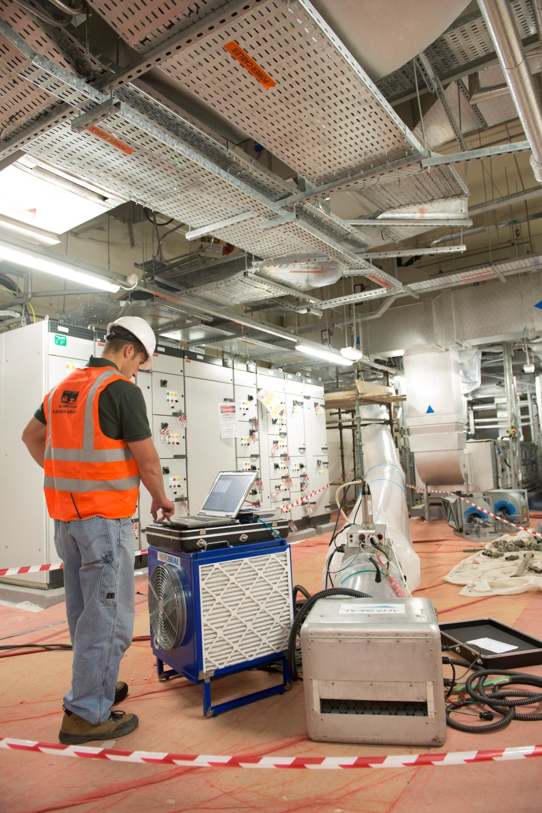
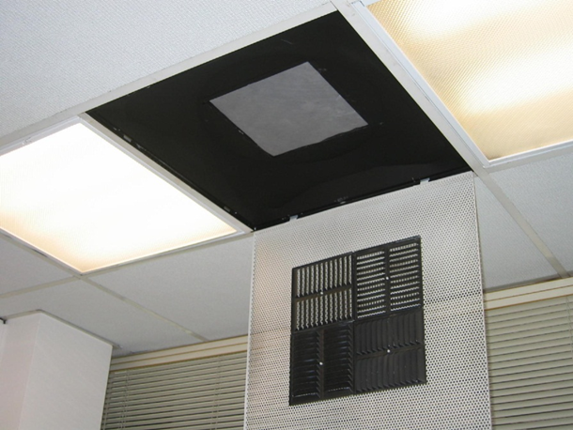
Execution

Slide 13
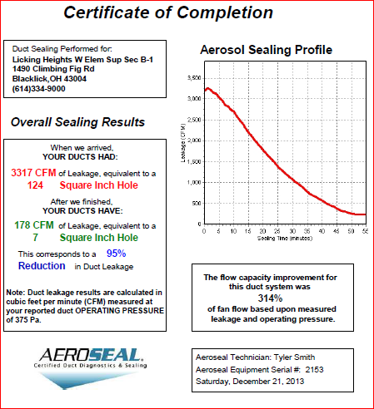
Certificate of Completion
When we arrived
YOUR DUCTS HAD:
3,317 CFM of Leakage equivalent
After we finished
YOUR DUCTS HAVE
178 CFM of Leakage equivalent
This corresponds to a 95%
Reduction in Duct Leakage

Slide 14
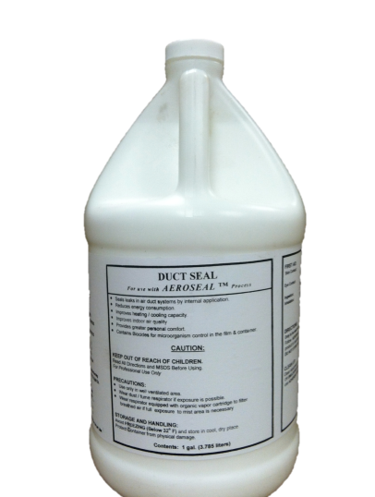
Sealant FAQs
Vinyl Acetate Polymer
  Base for chewing gum, hair spray and water-based paints
  Remains Rubbery
Certified in accordance with UL 1381 for:
  Surface Burning
  Mold Growth and Humidity
  Interior Duct Burning
  Leakage reduction
  Durability
Low VOC Content
2 hours to cure
3-year guarantee

Slide 15
Application FAQs
Seals gaps up to 5/8” span
No duct cleaning required prior to application (unless build-up in duct is >1/8”)
Can be used with lined, sheetrock or masonry ducts
No need to remove dampers
Must isolate equipment (VAV, fans, units, coils) from sealant stream
Must cover smoke detectors
Best applied when spaces are unoccupied and technicians have full access to rooms and areas to monitor sealing process

Slide 16
Installation Examples
Healthcare
University of Ottawa Heart Research Institute
Roudebush VA Hospital
Mayo Clinic
California Pacific / Sutter Health Hospital
Healthcare
Nemours Children Hospital
Winthrop Hospital
New York University Hospital
Arzanah Medical Complex, Abu Dhabi
Military
Camp LeJeune
NavAir Command Center
Newport Naval Training School
Fort Jackson
Higher Education
Ohio State University
Princeton University
Syracuse University
UC Davis
Multi-Family / Office Bldg.
Met-Life Bldg.
Hyundai HQ
Critical Applications
Cleveland Art Museum
U.S. House of Representatives
Deep Panuke Oil Platform

Slide 17
Healthcare – University of Ottawa Heart Institute
Canada’s largest cardio-vascular health center
Issue: Lab exhaust leaks causing radioactive isotope migration
Result: 94% reduction in leakage
“The positive impact that Aerosealing the shaft had on system performance was clear and immediate.”
Michele Emond,
University of Ottawa

Slide 18
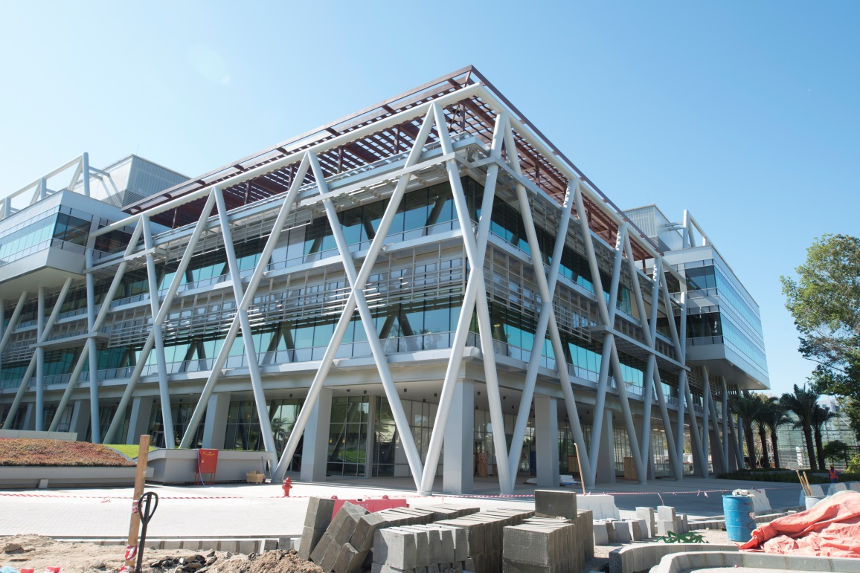
Healthcare - Arzanah Medical Complex
New LEED Gold 220,000 sqft medical complex
Issue: Supply and return air duct leakage exceeded specifications
Result: 94% reduction in leakage
“Aeroseal proved safe for use even in a hospital. Aeroseal was so effective at eliminating leaks, That we decided to expand the project to include The building’s entire HVAC system.”
Gus Heber
Habtoor Leighton

Slide 19
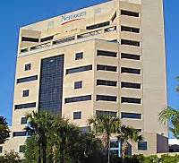
Healthcare - Nemours Children Hospital
630,000 sqft, 137 bed children’s hospital
Issue: General exhaust leakage contributing to nocosomial infection rates
Result: 85% reduction in leakage
“After sealing the leaks with Aeroseal, all floors are getting the
ventilation they need. As a side benefit, we were able to dramatically
reduce the speed of the exhaust fan, which has resulted in substantial
energy savings for the clinic.”
Chuck Boynton
Carrier Corp

Slide 20
Higher Education - Ohio State University
Project Goal: Eliminate duct air leaks in 19 ventilation shafts to pass fire code specs and to achieve LEED Silver Certification.
Aeroseal Result: All shafts sealed to specifications in under two weeks.
“Aeroseal easily solved one of the biggest challenges we had. Our only other option – tearing down the walls to access the shafts - would have set the grand opening back by months and added an astronomical cost to the project. Aeroseal worked.”
Brian Miller
Smoot Construction

Slide 21
Higher Education – Syracuse University
Project Goal: Obtain $170k rebate from New York’s NYSERDA Rebate Program for New Construction
Requirement: Eliminate 90% of all duct leaks.
Aeroseal Result: >90% reduction in duct leakage achieved.
“As energy efficiency standards become increasingly stringent, we will need to turn to new technologies like Aeroseal. It was a game changer for this project and a key to our ability to meet the NYSERDA requirements.”
Sam Doss
Hayner Hoyt Corporation

Slide 22
Commercial Class Office Bldg.- 600 Steamboat Rd.
Project Goal: Improve airflow in over 8,000 sqft of complex concrete HVAC ductwork serving a 200,000 sqft waterfront development.
Aeroseal Result: >90% of duct leakage eliminated.
“When you consider that 90% of commercial property out there today
has leaky ducts, Aeroseal represents a real boon to building owners
looking to increase indoor air quality and dramatically reduce energy costs.”
Kenneth Coffey
Tech Clean Industries, LTD

Slide 23
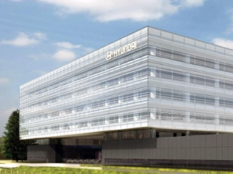
Commercial Class Office Bldg. – Hyundai US HQ
Project Goal: Reduce duct air leaks in large smoke exhaust and outside air shafts in 500,000 sq. ft. LEED Gold Certified Bldg.
Aeroseal Result: Duct air leakage reductions achieved.

Slide 24
Summary of Aeroseal Benefits
Lower Utility Bills
Improve IAQ
Eliminate Pressurization Problems
Typical Payback 2-7 Years

